Slide 1

307304 Business Intelligence and Data Mining
Simple Linear Regression

Slide 2
Topics and Learning Outcomes
What You'll Learn:
The concept of supervised learning
Understanding regression analysis fundamentals
Types of linear regression models
Best-fit line and OLS method
Closed-form solution implementation
Gradient descent algorithm
Linear regression assumptions
Evaluation metrics and performance assessment
Practical implementation with scikit-learn

Slide 3
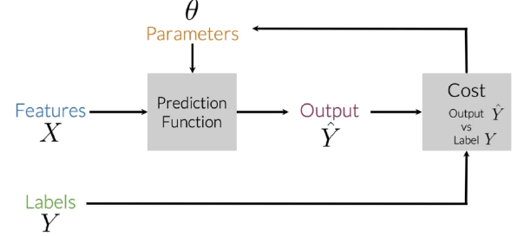
Supervised Machine Learning
Supervised machine learning is a type of learning where a model learns from labeled data.
The process follows these key steps:
Input Features (X): The model takes input data (features) which represents the information used to make predictions.
Prediction Function: The model, with some parameters (θ), processes the input data to generate predictions (Ŷ).
Output (Ŷ): This is the model’s prediction based on the input features.
Cost Function: The predicted output (Ŷ) is compared to the actual labels (Y) to calculate an error or "cost."
Optimization: The model adjusts its parameters (θ) of the cost function to minimize the error, improving its predictions over time.
This process repeats iteratively until the model achieves good accuracy.
It's commonly used for tasks like classification (e.g., spam detection) and regression (e.g., predicting house prices).

Slide 4
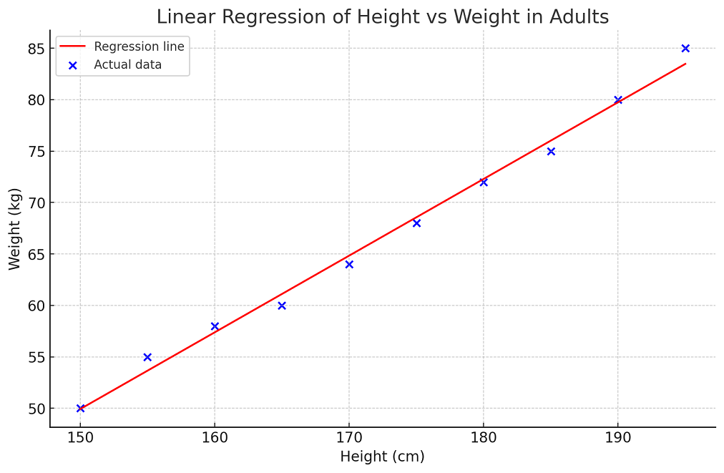
What is Regression Analysis?
Definition and Purpose
Linear Regression is a supervised machine learning algorithm that models the linear relationship between:
Dependent variable (target): What we want to predict
Independent variable(s) (features): What we use to make predictions
Key Concept: Fits a linear equation to observed data to make predictions on new, unseen data.
Real-World Applications:
Predicting house prices based on size
Estimating sales revenue from advertising spend
Forecasting stock prices using economic indicators

Slide 5
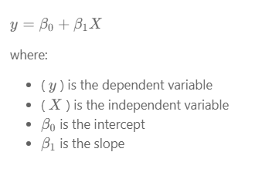
Types of Linear Regression
There are two main types of linear regression:
1- Simple Linear Regression
This is the simplest form of linear regression, and it involves only one independent variable and one dependent variable.
The equation for simple linear regression is:

Slide 6
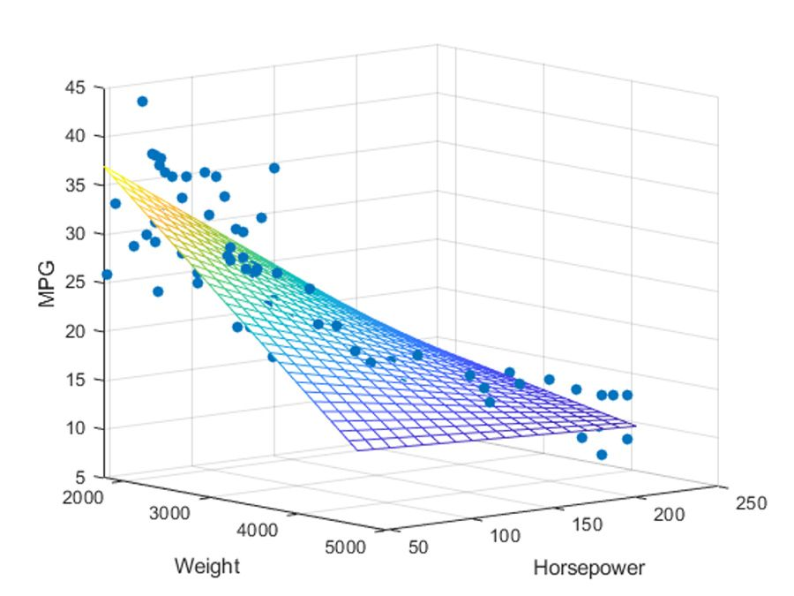
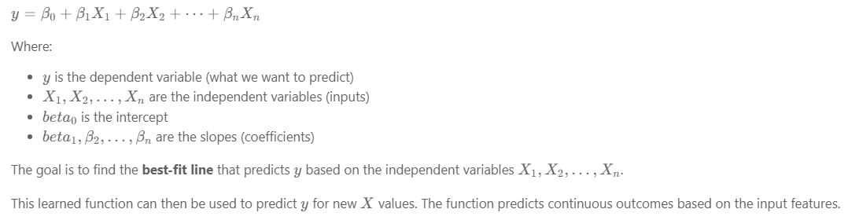
Types of Linear Regression
2- Multiple Linear Regression (Simplified)
In multiple linear regression, there is one dependent variable and more than one independent variable.
The equation is:

Slide 7
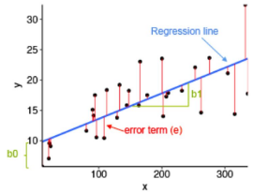
What is the Best Fit Line?
In linear regression, the best-fit line is the line that minimizes the error between the predicted and actual values.
It represents the relationship between the dependent and independent variables.
The goal is to change the slope and the intercept of the line to make the most accurate predictions.
Linear regression predicts Y based on X, using a straight line to model the relationship. For example, X could be work experience, and Y could be salary. The goal is to find the best-fit line that minimizes the error between predicted and actual values.
To find this line, we use a cost function, which helps determine the best values for the line's coefficients.

Slide 8
Why Linear Regression Matters
Four Key Benefits:
Interpretability
Clear, understandable coefficients
Easy to explain relationships between variables
Simplicity
Transparent and easy to implement
Foundation for more complex algorithms
Basis for Advanced Models
Building block for regularization (Ridge, Lasso)
Foundation for support vector machines
Assumption Testing
Validates key data assumptions
Critical for statistical analysis

Slide 9
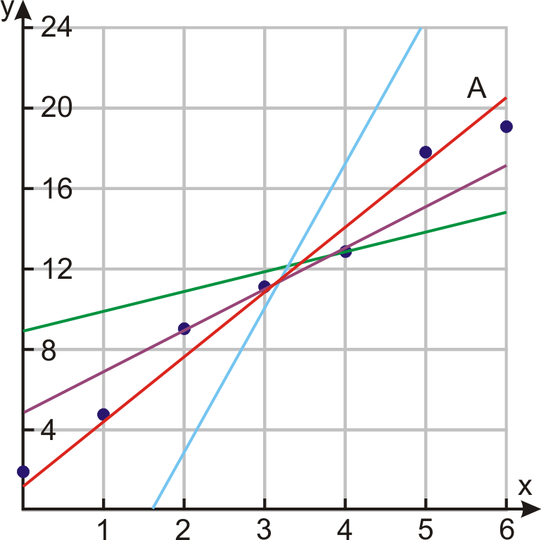
The Best-Fit Line Concept
What Makes a Line "Best-Fit"?
The best-fit line minimizes the error between predicted and actual values.
Key Components:
Slope (β₁): How much Y changes for each unit change in X
Intercept (β₀): Value of Y when X = 0
Goal: Find the line that makes the most accurate predictions
Mathematical Representation:
Ŷ = β₀ + β₁X
Where Ŷ is the predicted value.

Slide 10
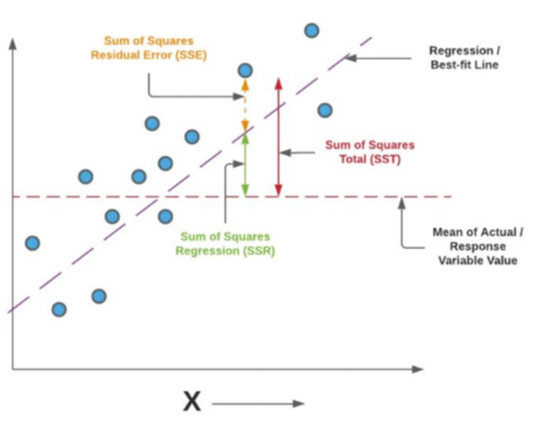
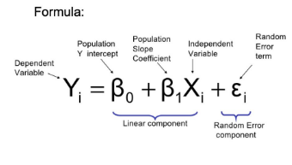
Ordinary Least Squares (OLS) Method
The Foundation of Linear Regression
OLS Principle: Find the line that minimizes the sum of squared differences between observed and predicted values.
Why "Least Squares"?
Squares prevent positive and negative errors from canceling out
Penalizes larger errors more heavily
Provides unique, mathematically optimal solution

Slide 11
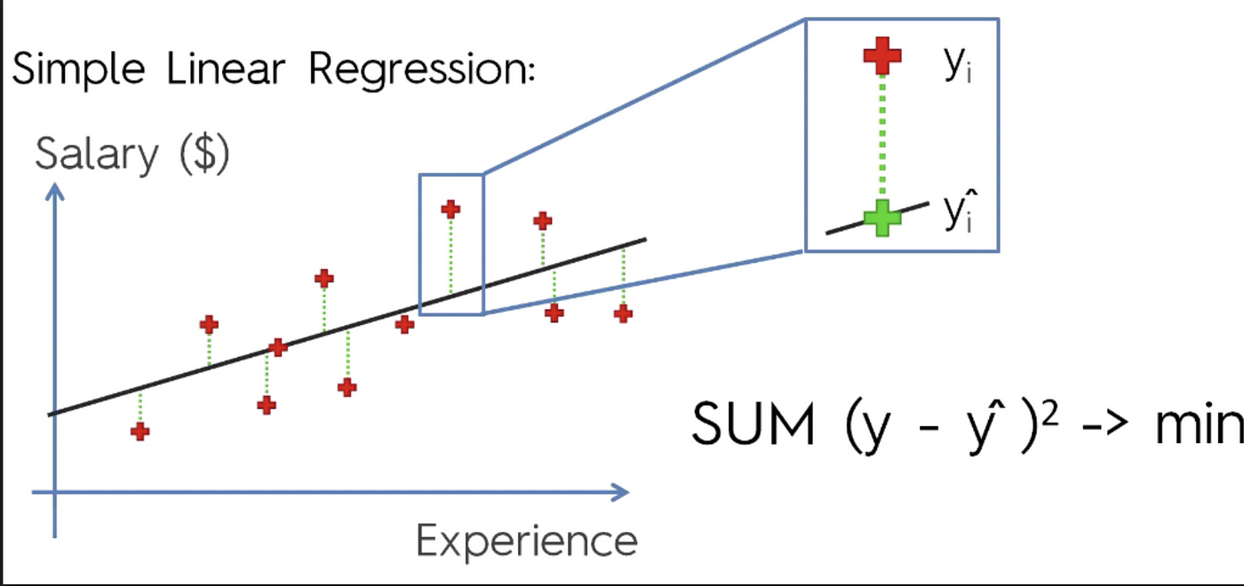

Cost Function - Mean Squared Error
Measuring Prediction Quality
The Mean Squared Error (MSE) quantifies how well our model performs.
Formula:
Key Points:
Lower MSE = Better model performance
Units are squared (e.g., dollars² for price prediction)
Always positive (due to squaring)
Heavily penalizes large errors

Slide 12
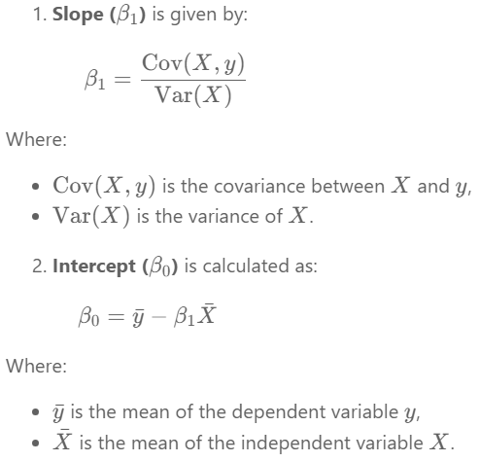

Solving Linear Regression with the Closed-Form Solution
The closed-form solution is efficient for small to medium-sized datasets, especially in simple linear regression, where slope and intercept can be computed directly without matrix operations.
However, for multiple linear regression, the closed-form solution involves computing the inverse of X^T.X, which becomes computationally expensive as dataset size and dimensionality grow.
It works well when:
The dataset is small (typically up to a few thousand rows).
The number of features is low.
There is no multicollinearity (i.e., features are not highly correlated).
For larger or more complex problems, iterative methods like Gradient Descent are preferred due to their scalability and efficiency.

Slide 13
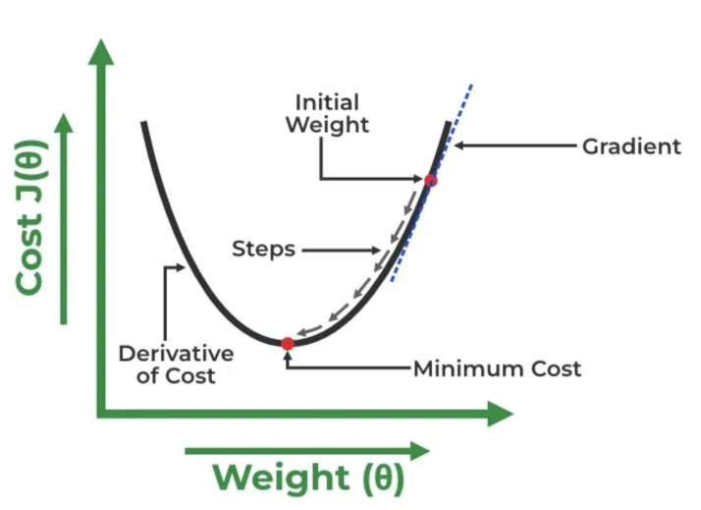
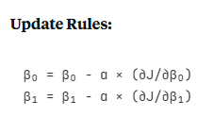
Solving Linear Regression Using The Gradient Descent Method
Iterative Optimization Approach
Core Concept: Gradually adjust coefficients to minimize cost function
Algorithm Steps:
Start with random β₀ and β₁ values
Calculate cost (MSE)
Compute gradients (derivatives)
Update coefficients in direction of steepest descent
Repeat until convergence

Slide 14
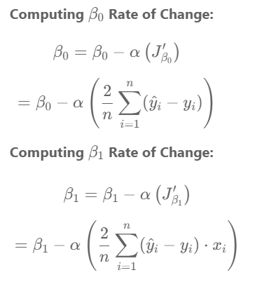
Gradient Descent Visualization
Understanding the Optimization Process
Key Components:
Learning Rate (α): Step size for each iteration
Gradient: Direction of steepest increase
Convergence: Reaching the minimum cost

Slide 15
Gradient Descent Visualization
Advantages:
Scales well to large datasets
Works with multiple features
Foundation for deep learning
Considerations:
Requires tuning learning rate
May need many iterations
Can get stuck in local minima

Slide 16
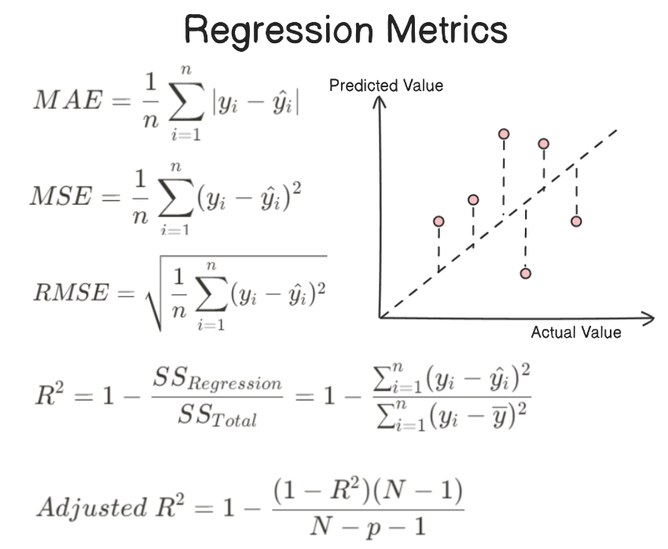
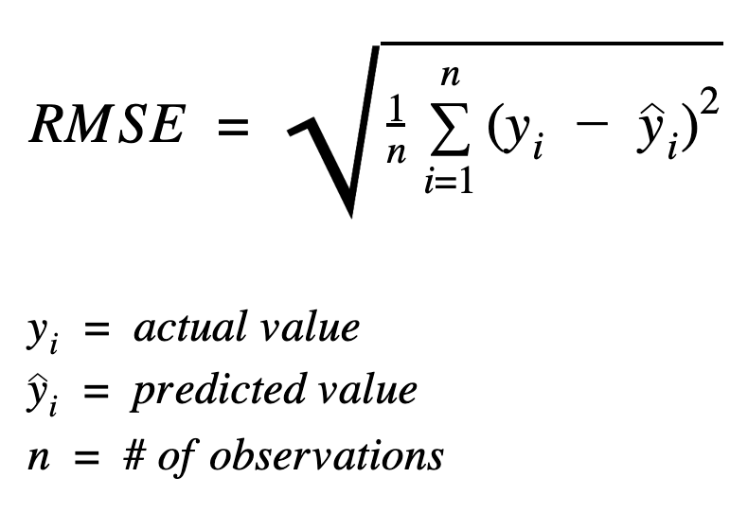
Evaluation Metrics

Slide 17
Assumptions of Linear Regression
1. Linearity
The relationship between the independent variables (predictors) and the dependent variable (response) should be linear.
This means that the change in the dependent variable is proportional to the change in the independent variable.
Example: If you are predicting house prices (dependent variable) based on the size of the house (independent variable), a linear relationship implies that each additional square foot of the house size increases the price by a constant amount.

Slide 18
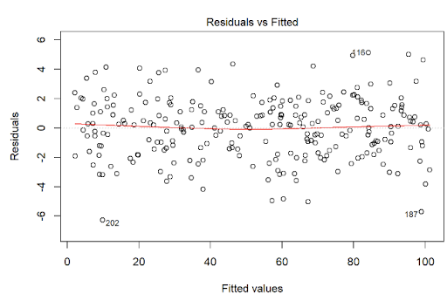
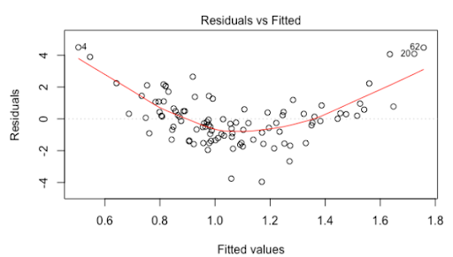
Assumptions of Linear Regression
How to Test Linearity: Plot the residuals vs. predicted using a scatter plot, look for a random distribution (no patterns).
To check if the relationship between the independent variable (Size) and the dependent variable (Price) is linear, we plot the residuals against the fitted values and look for patterns in the residuals, a random scatter indicates a linear relationship while curves or trends suggest a non-linear relationship.

Slide 19
Assumptions of Linear Regression
2. Independence
Observations should be independent of each other.
This means that the residuals (errors) should not be correlated across observations.
This assumption is important for the validity of standard statistical tests.
Example: In a study measuring the effect of a new drug on blood pressure, each patient's measurement should be independent. If measurements from the same patient at different times are used, they are not independent.
How to Test: Use the Durbin-Watson test to check for autocorrelation in residuals, particularly for time-series data.
This test calculates a test statistic (range 0-4). A value around 2 indicates no autocorrelation, values <2 suggest positive autocorrelation, and >2 indicate negative autocorrelation.

Slide 20
Assumptions of Linear Regression
3. Homoscedasticity
The variance of the error terms (residuals) should be constant across all levels of the independent variables.
If this assumption is violated, it indicates heteroscedasticity, meaning the spread of residuals varies at different levels of the independent variables.
Example: When plotting residuals against fitted values in a regression analysis of apartment prices against apartment size, the spread of residuals should be roughly constant. If residuals spread out more as apartment size increases, this indicates heteroscedasticity.

Slide 21
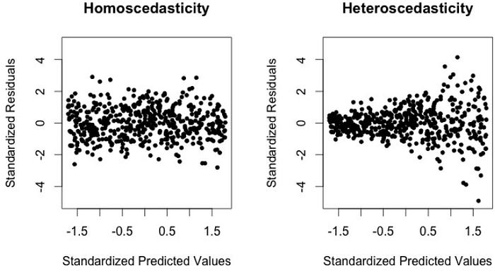
Assumptions of Linear Regression
How to Test Homoscedasticity : Plot residuals vs. predicted values. The spread of residuals variance should be consistent (no funnel-shaped patterns).
Good Residual Spead
Good Linear Relation
Not a Good Residual Spead
Not a Good Linear Relation
التوزيع العشوائي للنقاط حول الصفر على طول المدى هو التوزيع الأفضل الذي يبين أن الموديل الخطي مناسب
Funnel shape note good
الشكل مثل القمع يبين بأن العلاقة الخطية غير مناسبة

Slide 22
Assumptions of Linear Regression
4. Normal Distribution of Errors
The error terms should be normally distributed. This assumption is especially important for small sample sizes because it affects the validity of confidence intervals and hypothesis tests.
Example: After fitting a regression model predicting apartment price based on apartment size, plotting a histogram or a Q-Q plot of the residuals should show that they follow a normal distribution.
Residuals | Standard Residuals | Rank | Percentiles | Theoritical Residuals
-32.890625 | -1.425656831 | 1 | 0.05 | -1.644853627
-30.78125 | -1.334225158 | 2 | 0.15 | -1.036433389
-13.59375 | -0.589226339 | 3 | 0.25 | -0.67448975
-6.484375 | -0.281067736 | 4 | 0.35 | -0.385320466
-3.671875 | -0.159158839 | 5 | 0.45 | -0.125661347
-0.859375 | -0.037249941 | 6 | 0.55 | 0.125661347
7.734375 | 0.335249469 | 7 | 0.65 | 0.385320466
14.921875 | 0.646794429 | 8 | 0.75 | 0.67448975
26.328125 | 1.141202737 | 9 | 0.85 | 1.036433389
39.296875 | 1.703338209 | 10 | 0.95 | 1.644853627

Slide 23
Assumptions of Linear Regression
5. No Multicollinearity
Independent variables should not be too highly correlated with each other.
High correlation between predictors (multicollinearity) can inflate the variances of the coefficient estimates and make the model unstable.
Example: In a regression model predicting salary based on education level and years of experience, if education level and years of experience are highly correlated, it could cause multicollinearity issues.
How to Test: Calculate Variance Inflation Factor (VIF).
VIF values above 10 (or sometimes 5) indicate high multicollinearity.
A VIF >10 (or sometimes >5) indicates problematic multicollinearity.

